Slide 1

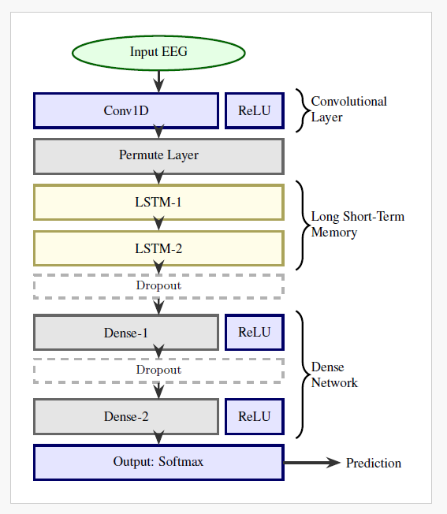
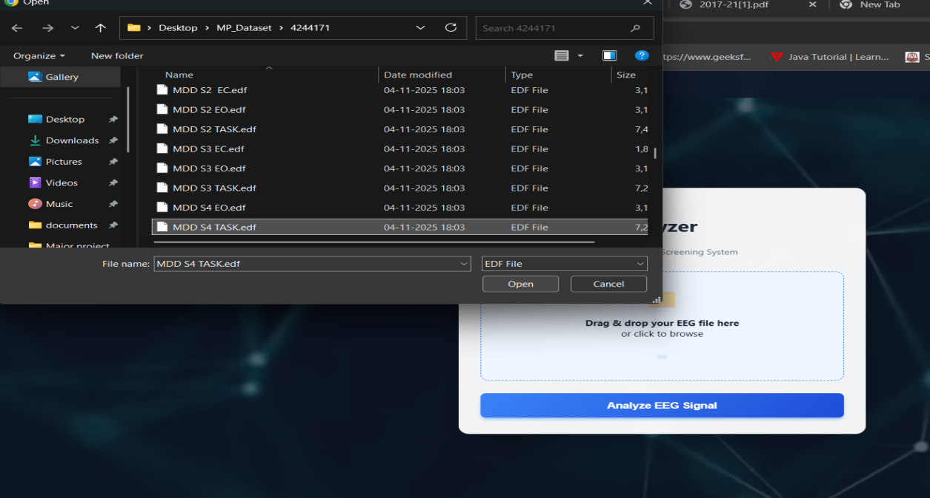
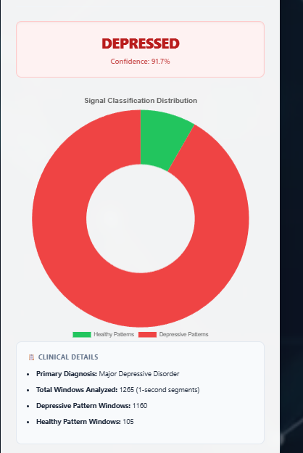
AAVISHKAR - 2025
12th December 2025
ARTIFICIAL INTELLIGENCE AND DATA SCIENCE
Project Title: “A Hybrid Neural Network for EEG-based Depression Screening Using CNN+LSTM”
Abstract
Depression is a widespread psychological disorder affecting people of all ages. Early diagnosis is crucial, and EEG signals can help assess mental health. This project proposes a fully automated Depression Detection System using a novel Hybrid Neural Network, DepHNN, which combines CNN for temporal learning and LSTM for sequence learning. EEG data from 34 depressed and 30 normal drug-free individuals were used. The system achieves 98.27 accuracy and a MAE of 0.0237, offering an efficient, accurate, and low-complexity solution for EEG-based depression screening.
Methodology
1. Data: EEG dataset (19-channel, eyes-closed) with 34 MDD and 30 Healthy subjects.
2. Preprocessing: 0.5–45 Hz filtering, ICA artifact removal, Z-score normalization, 1-sec window segmentation.
3. Model: Hybrid CNN-LSTM (DepHNN) built with TensorFlow for Healthy vs Depressed classification.
4. Deployment: Django backend + secure login, responsive UI, Chart.js graphs, and real-time EEG prediction.
Introduction
Depression affects over 322 million people worldwide, with a higher incidence among females. Although it is a treatable condition, nearly half of the cases remain undiagnosed due to factors like limited awareness, insufficient resources, and incorrect diagnoses. EEG signals, being non-invasive and cost-effective, serve as valuable biomarkers for identifying neurological disorders, including depression. However, their complexity makes manual analysis challenging. To address this, the project proposes a hybrid LSTM-CNN model (DepHNN) for efficient and accurate detection of depression using EEG data.
Results
Objectives
Improve adaptability using cross-validation and diverse datasets.
Apply regularization techniques such as L2 regularization and adaptive learning rate optimization.
Develop a CNN-LSTM model for automated depression detection using EEG signals.
Enhance model accuracy and generalization using dropout, data augmentation, and early stopping.
Minimize computational complexity and latency to enable real-time depression screening on portable and cloud-based platforms.
Conclusion
DepHNN is a hybrid deep learning model combining CNN and LSTM for automated depression detection using EEG signals. It efficiently extracts temporal and sequential features without manual engineering and achieves high accuracy with minimal error and computation time. The model surpasses existing approaches in accuracy, efficiency, and robustness, making it a reliable computer-aided tool for early depression screening. Future improvements can enable severity analysis, use of larger datasets, and integration with IoMT systems for real-time mental health monitoring.
Name of Guide:
Project Batch
Badrinath K
Assistant Professor
Balappagari Latha Sree 1SJ22AD006
C S Mounika 1SJ22AD008
Mareddy Charan 1SJ22AD034

